Slide 1
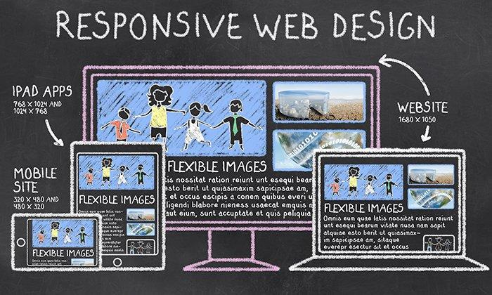
A responsive & Multipage Website designing
Project name - Prachi - Construction website
Submitted by - Tushar M. Patil.

Slide 2
project's goal: "To create a multipage, responsive website."
Introduction
This presentation will provide you with valuable insights into creating a multipage, responsive website.
But what exactly does that mean?
A multipage website offers a rich, multi-dimensional experience to its visitors. It's a collection of interconnected pages that tell a story, convey information, and engage users in various ways. It's your online storefront, portfolio, blog, or platform for sharing your passion with the world.
Now, the term "responsive" is equally important. With the diversity of devices people use to access the internet today—ranging from large desktop monitors to smartphones and tablets—your website must adapt seamlessly to different screen sizes and resolutions. This adaptability ensures that every visitor, regardless of the device they're using, has a positive and user-friendly experience.

Slide 3
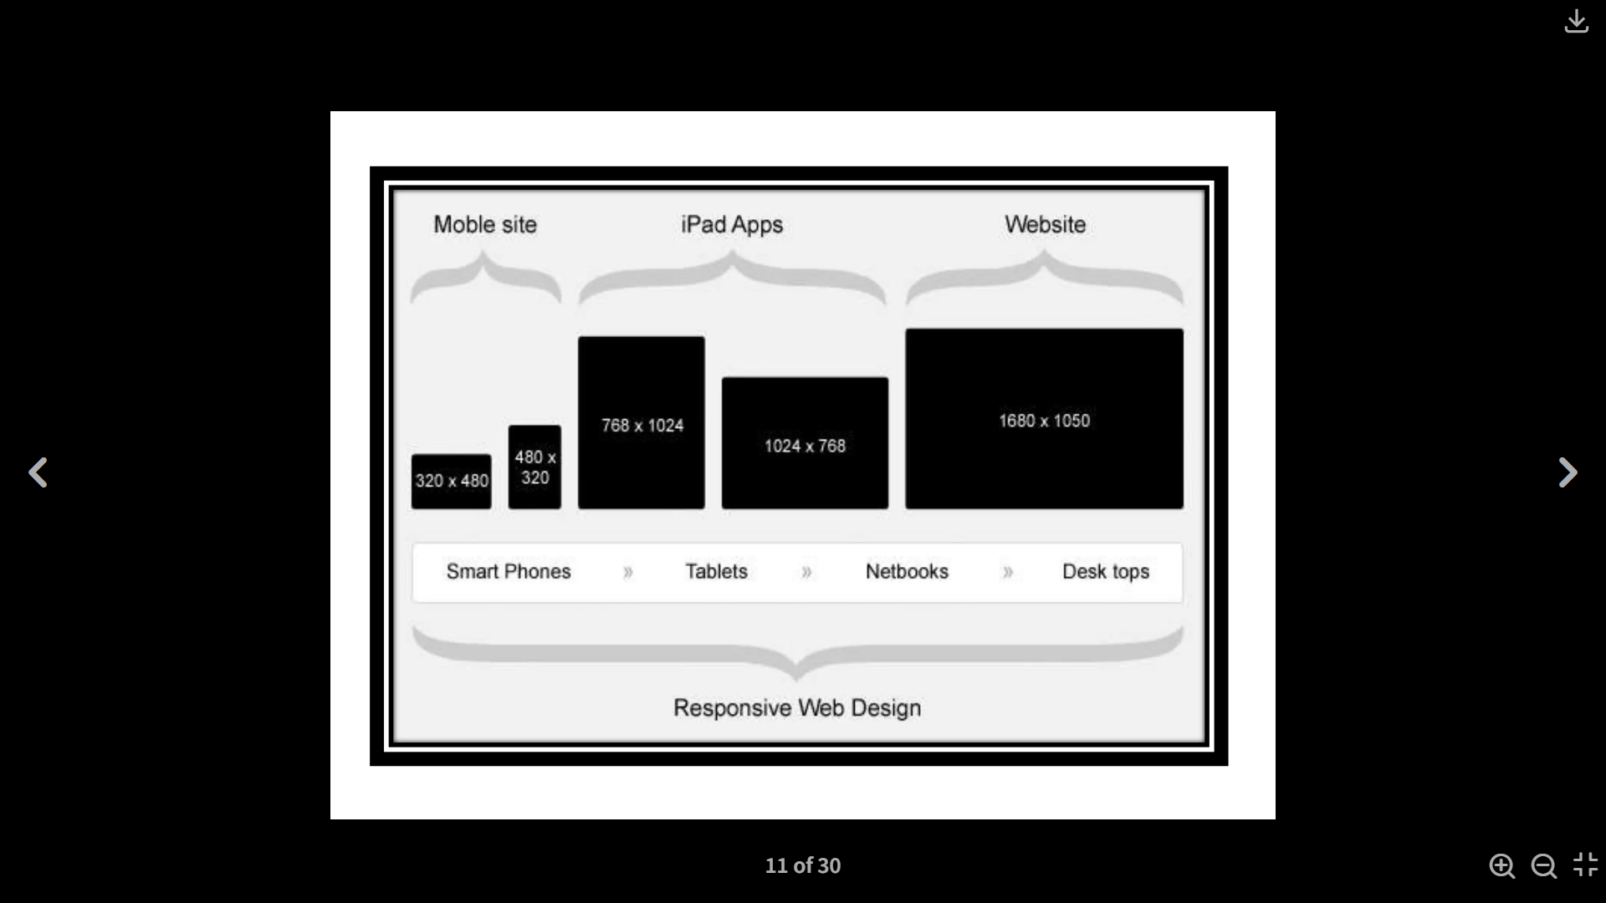
"Responsive design ensures that our website looks and works well on various devices and screen sizes."
Responsive Design

Slide 4
1. Portfolio Page 2. Blog Page 3. Contact Form 4. Meet the Team
Multipage Design
List the key features of this website:

Slide 5
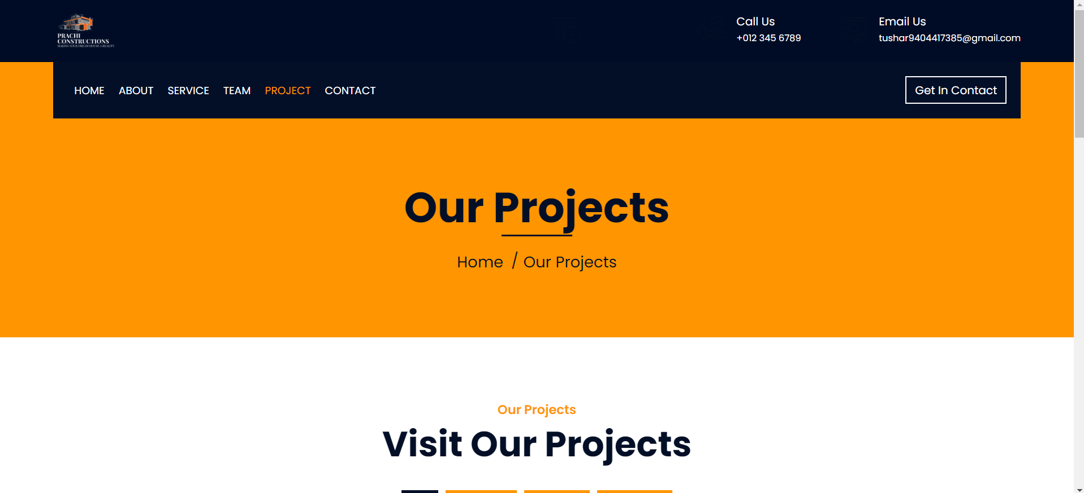
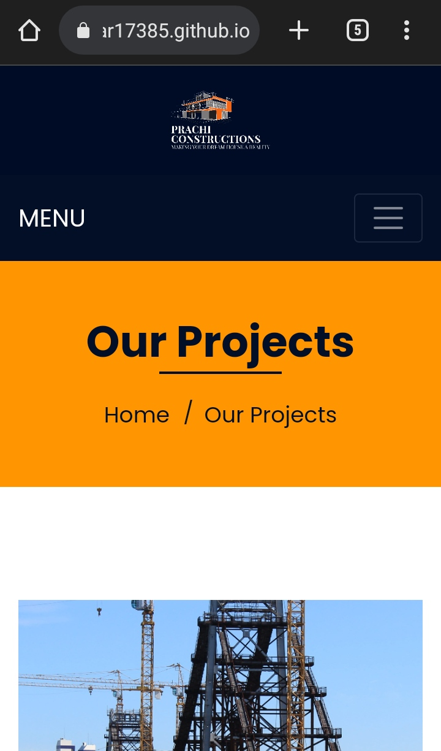
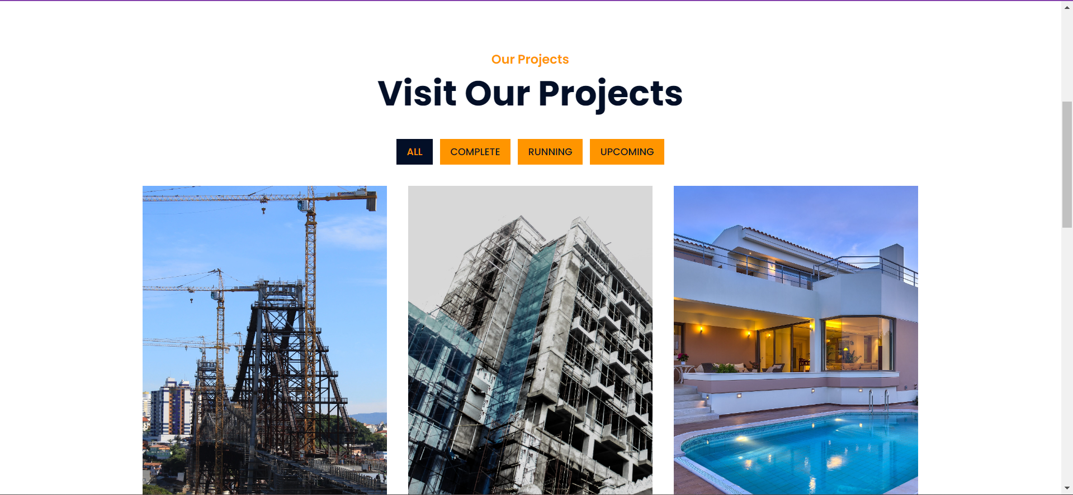
Portfolio Page
Page Examples
Website View
Mobile View

Slide 6
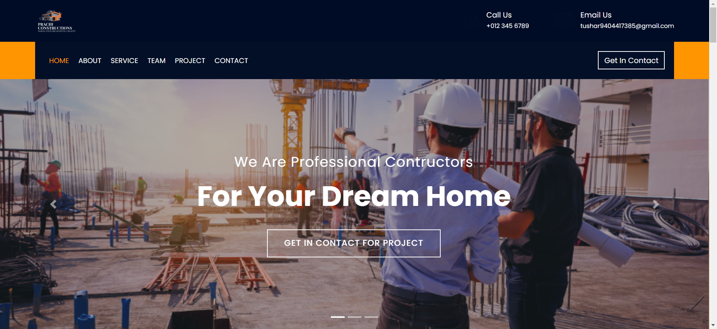
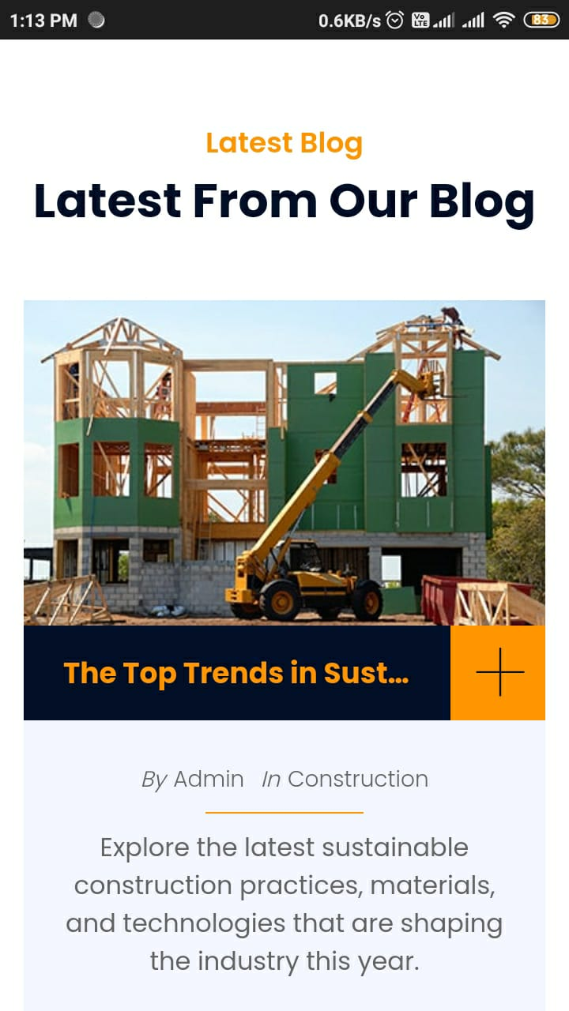
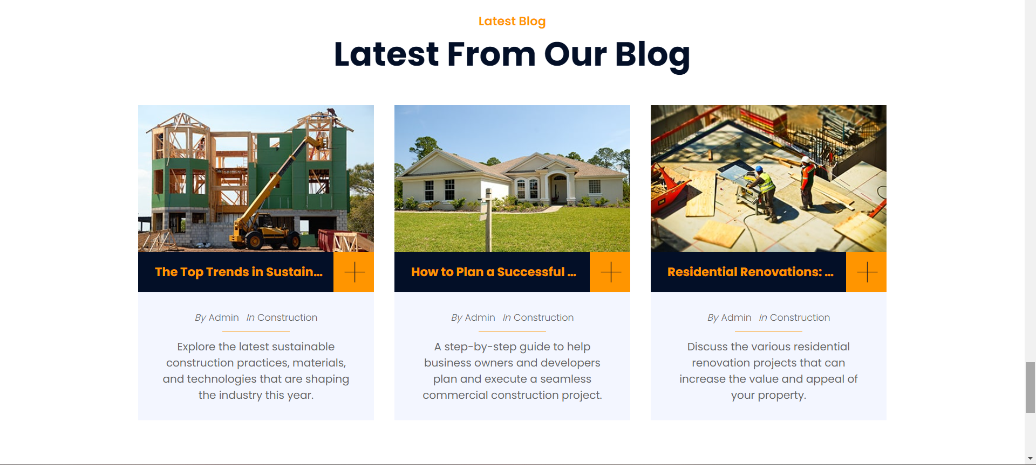
Blog Page
Page Examples
Website View
Mobile View

Slide 7
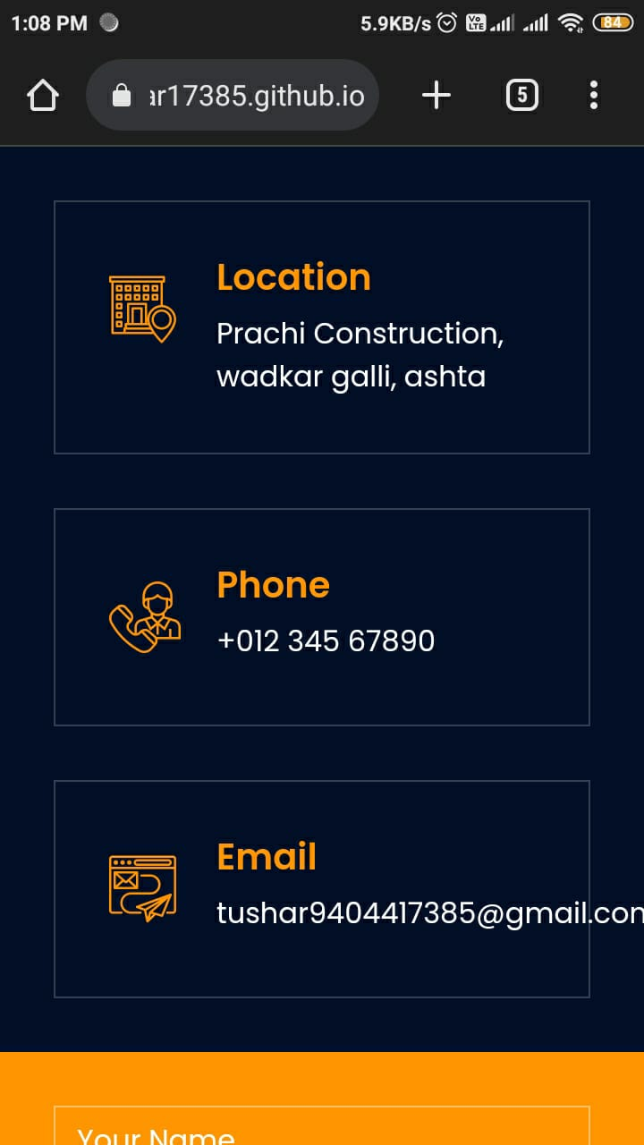
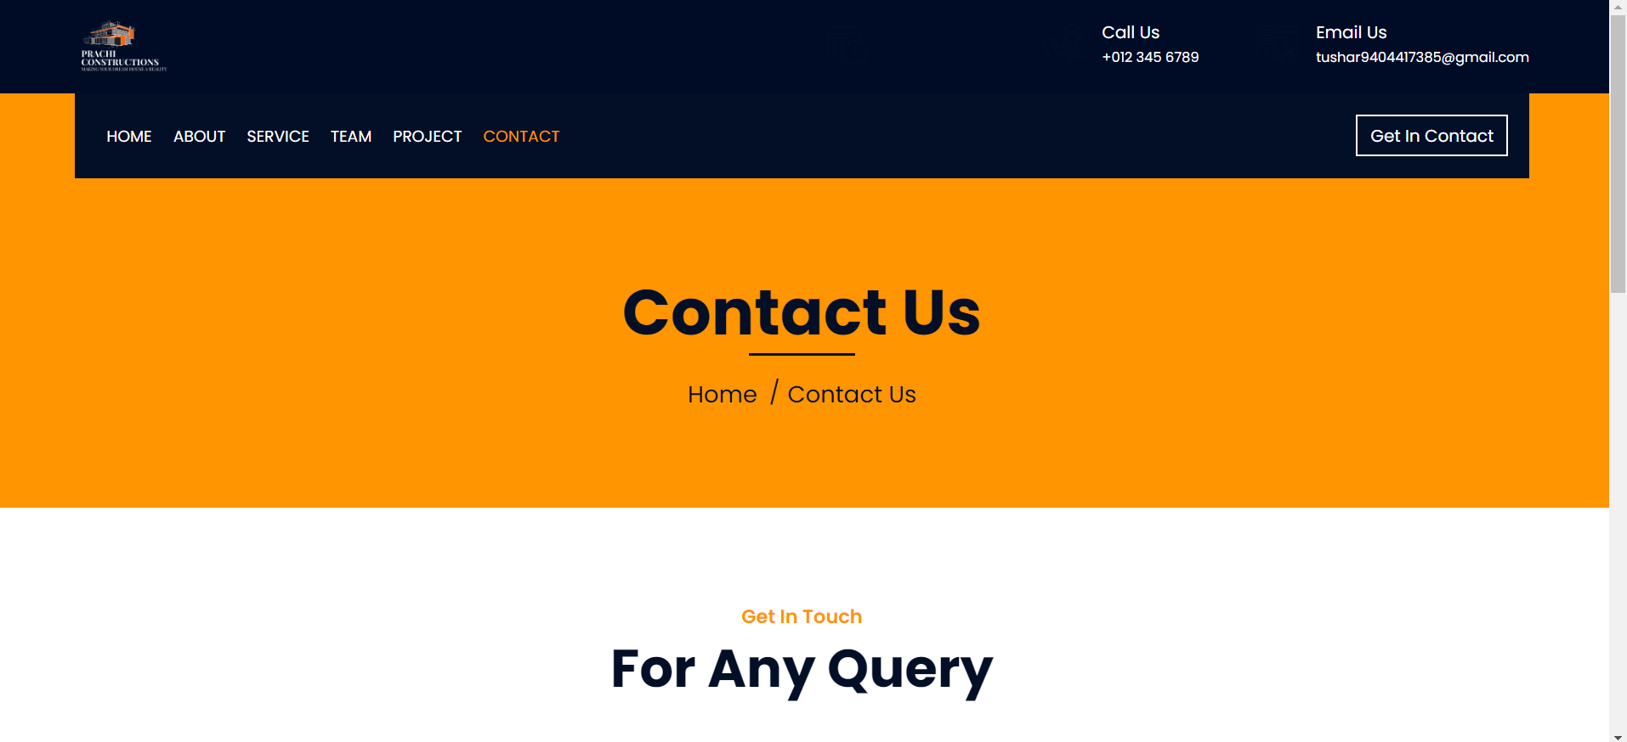
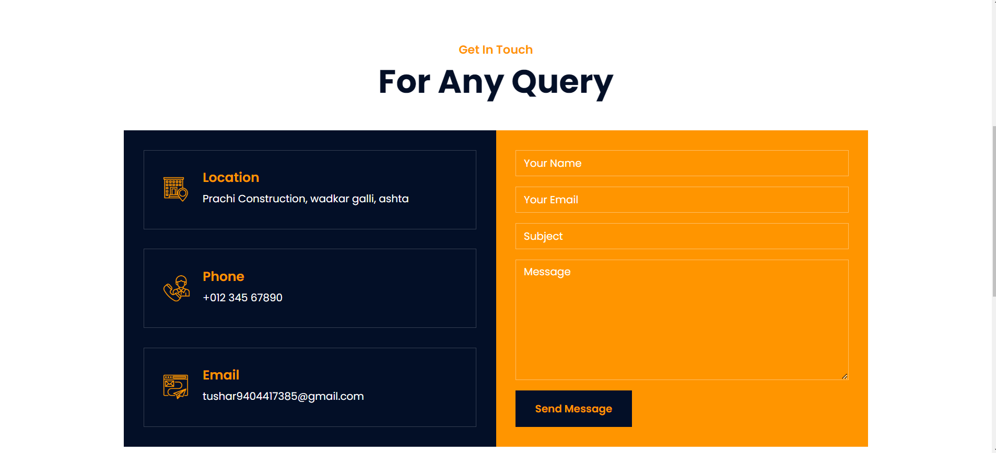
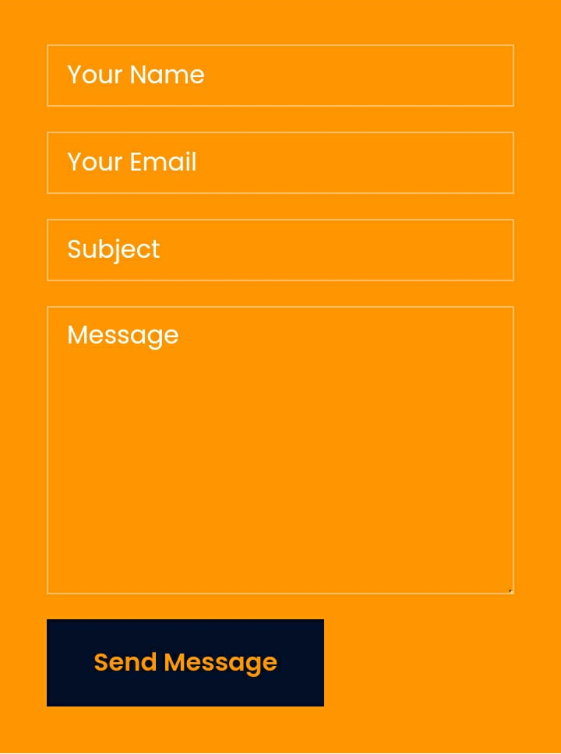
Contact Form
Page Examples
Website View
Mobile View

Slide 8
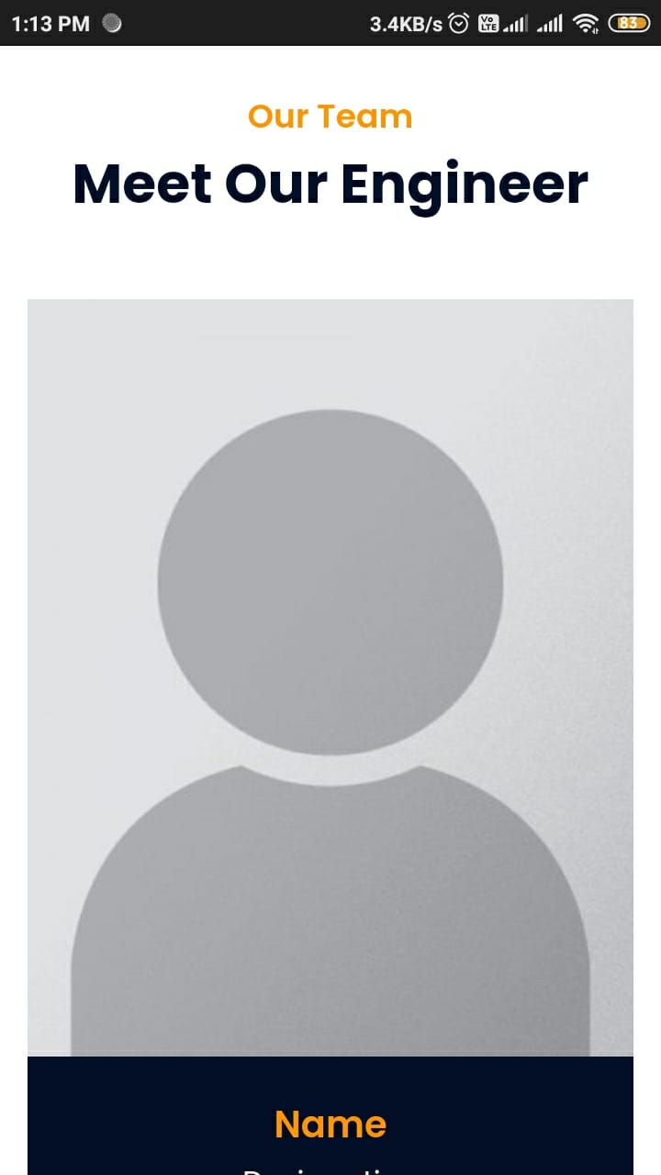
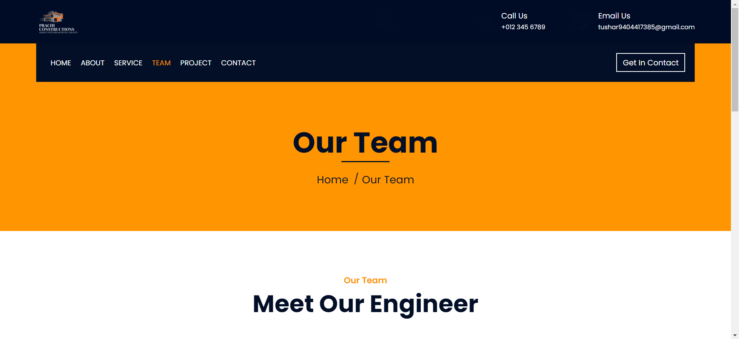
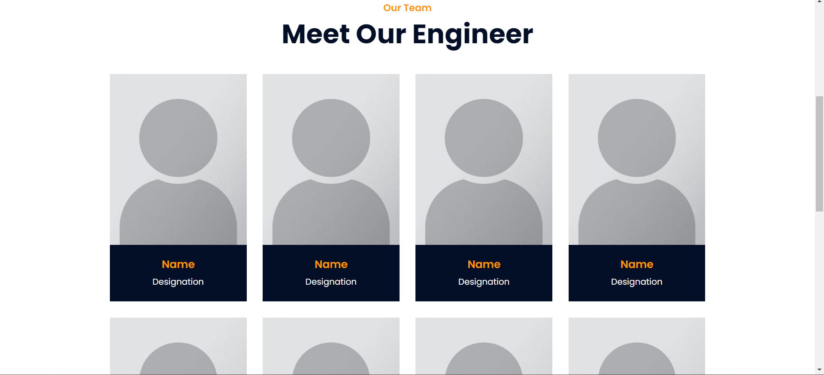
Meet the team
Page Examples
Website View
Mobile View

Slide 9
List the technologies and tools used in this project:
Technologies Used
HTML
CSS
JavaScript
Bootstrap Framework
Flaticon.com for icons
Emailjs.com api for mail sending

Slide 10
challenges encountered during the project:
Challenges Faced
"Ensuring consistent design across devices."
"Optimizing website performance for mobile."
"Testing on various browsers."

Slide 11
Thank You!

